Slide 1
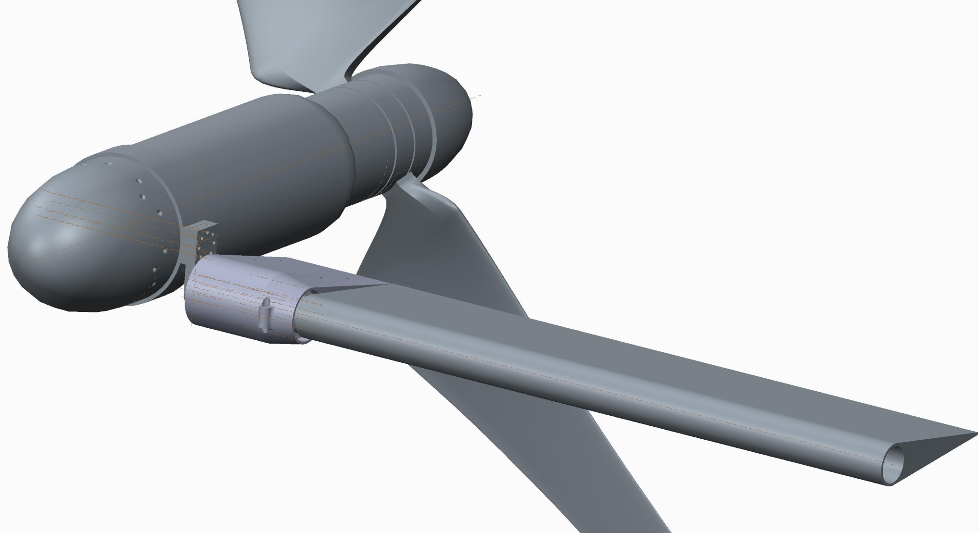
Transverse Structure Review
Component Layout
Transverse structure to be used as ballast
Desire to offset vertically from center of nacelles
Current thought is to optimize structure on wake, not on weight
Desire to re-use existing componentry

Slide 2
Transverse Structure Review

Slide 3
Transverse Structure Review

Slide 4
Transverse Structure Review
 | Description | Symbol | Value | Unit | Coord. Sys | Direction / Convention | Type
Blade | Blade Thrust |  | 200 | [N] | Rotor |  | Steady
 | Blade Root Bending Moment |  | 40 | [N-m] | Rotor |  | Steady
 | Blade Torque |  | 18 | [N-m] | Rotor |  | Steady
 | Wake Deficit |  | 50 | [%] | Rotor |  | Fatigue
Pod | Number of Blades |  | 2 | [ea] | [-] | [-] | [-]
 | Thrust (per Pod) |  | 400 | [N] | Navy | -X (downstream) | Steady
 | Torque (per Pod) | M_{x} | 35 | [N-m] | Navy | Mx | Steady
 | Torque oscillation (per blade pass) |  | 9 | [N-m] | Navy | Mx
 | Wet Weight of Pod |  | 0 | [N] | Navy | -Z (+float) | Steady
 | Moment due to wake |  | 20 | [N-m] | Navy | Mz | Fatigue
 | Moment due to shear |  |  | [N-m] | Navy | My | Fatigue
Beam | Drag Force on Beam (distributed) |  | 0 | [N/m] | Navy | -X (downstream) | Steady
 | Wet Weight of Beam (distributed) |  | 0 | [N/m] | Navy | -Z (+float) | Steady
 | C-Plane Width |  | 1.8 | [m] | Navy | Y
 | Beam Length |  |  | [m] | Navy | X (+fwd)
 | Beam Height |  |  | [m] | Navy | Z (+down)
Mooring | Mooring Force Horizontal |  | -800 | [N] | [-] | X (+fwd) | Steady
 | Mooring Force Vertical |  | 0 | [N] | [-] | Z (+down) | Steady
Material | Material |  | 6061 T6 | Aluminum Alloy
 | Elastic Modulus |  | 6.90E+10 | [N/m2]
 | Poissons Ratio |  |  | [-]
 | Shear Modulus |  |  | [N/m2]
 | Density |  | 2700 | [kg/m3]
 | Tensile Strength |  | 3.00E+08 | [N/m2]
 | Yield Strength |  | 2.41E+08 | [N/m2]

Slide 5
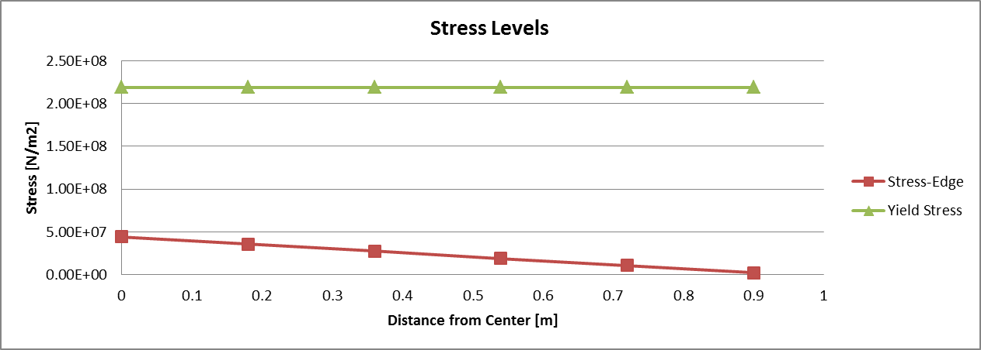
Transverse Structure Review

Slide 6
Transverse Structure Review

Slide 7
Transverse Structure Review
 | Connection | Type | Outside Threads | Inside Threads | Axial Force | Axial Stress
 |  |  |  |  | [N] | [Mpa]
Clamp1 | Clamp-Vert_Adapter | Bolt | SS | SS | 152.29 | 7.82
Clamp2 | Clamp-Vert_Adapter | Bolt | SS | SS | 1324.82 | 68.06
Clamp3 | Clamp-Vert_Adapter | Bolt | SS | SS | 815.41 | 41.89
Clamp4 | Clamp-Vert_Adapter | Bolt | SS | SS | 238.55 | 12.25
Vert1 | Vert_Adapter-Dyno | Screw | SS | ALUM | 223.56 | 12.55
Vert2 | Vert_Adapter-Dyno | Screw | SS | ALUM | 2661.67 | 149.41
Vert3 | Vert_Adapter-Dyno | Screw | SS | ALUM | -53.68 | -3.01
Vert4 | Vert_Adapter-Dyno | Screw | SS | ALUM | -9.20 | -0.52
Dyno1 | Dyno-Dyno_Adapter | Screw | SS | ALUM | 747.52 | 36.52
Dyno2 | Dyno-Dyno_Adapter | Screw | SS | ALUM | 1343.07 | 65.61
Dyno3 | Dyno-Dyno_Adapter | Screw | SS | ALUM | 162.80 | 7.95
Dyno4 | Dyno-Dyno_Adapter | Screw | SS | ALUM | -91.84 | -4.49
Pipe1 | Dyno_Adapter-Pipe | Screw | SS | ALUM | 1278.13 | 112.86
Pipe2 | Dyno_Adapter-Pipe | Screw | SS | ALUM | 2423.20 | 213.97
Pipe3 | Dyno_Adapter-Pipe | Screw | SS | ALUM | 487.60 | 43.06
Pipe4 | Dyno_Adapter-Pipe | Screw | SS | ALUM | -267.94 | -23.66

Slide 8
Transverse Structure Review
Next Steps
Bolt/Screw verification
Vertical Adapter to URS
Pipe to URS
Modify Fairing Adapter
Modify Piper Fairing
Cable routing
Provision for locking/unlocking fairing to pipe
Mooring attachment location

